Slide 1
Avoiding Academic Burnout
Matt Orr, PhD
Office of Continuous Professional Development & Strategic Affairs
University of South Carolina School of Medicine

Slide 2
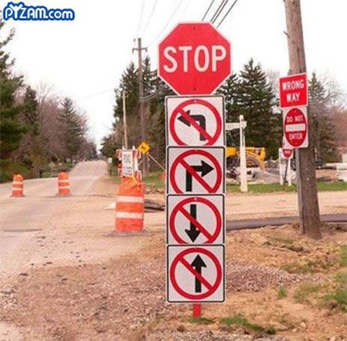
Three Options
Become independently wealthy
Marry someone who is independently wealthy
Do a U-Turn and find another career

Slide 3
Three Other, More Realistic Options
Self-Management
Situation Management
Priority Management

Slide 4
Self-Management
Know Thy Self
Purpose

Slide 5
What is Your Purpose?
Be clear on your purpose, why you do what you do. It will serve as your compass when you can’t see beyond what surrounds you.
Connect your purpose to what lies beyond yourself, what is bigger than you

Slide 6
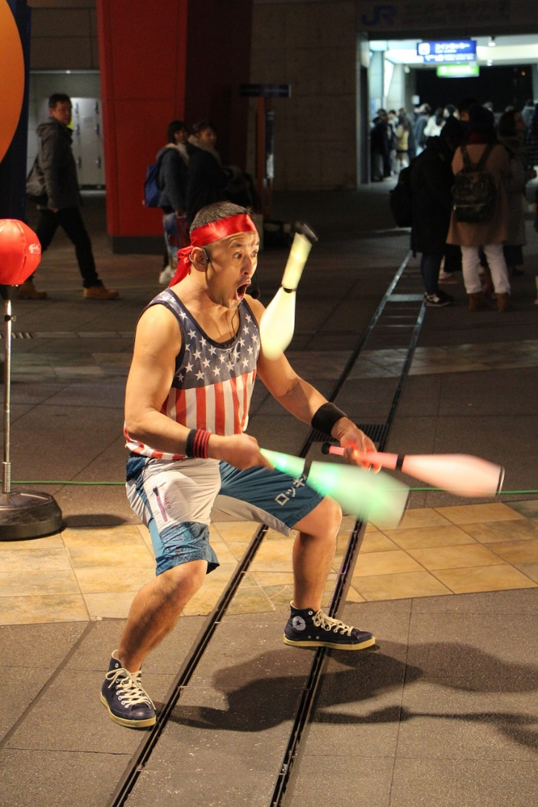
Engagement
Energetic state of involvement with personally fulfilling activities that enhance one’s sense of professional efficacy
Notes:
About the relationship with one’s work -Vigor Dedication Absorption
Not the same type of engagement that you often hear about in terms of “employee engagement”
Very closely related but difference is that most engagement in workplace terms is about whether you are motivated and willing to fulfill the mission and meet the goals of the company.
This view of engagement is about you as a professional, your relationship with work and whether you are fulfilled in the work that you do.
Want those two to align but my interest is in you.
Maslach C, Leiter MP. Early predictors of job burnout and engagement. Journal of Applied Psychology. 2008;93(3):498-512. doi:10.1037/0021-9010.93.3.498.

Slide 7
“Vigor & Aliveness”
ORIGIN
Of
Action
PAWN
Of
Action
(Ryan & Frederick, 1997)
Notes:
A dynamic component of aliveness

Slide 8
VALUES
ALIGNMENT
Notes:
We are not talking about work environments that are toxic to you and irreconcilable
Not an utter lack of fit
If gap is great & work culture prevents you from exercising this value, tune into a different one

Slide 9
Core Values
Standards or ideals that guide attitudes and behavior toward achieving
a goal or purpose

Slide 11
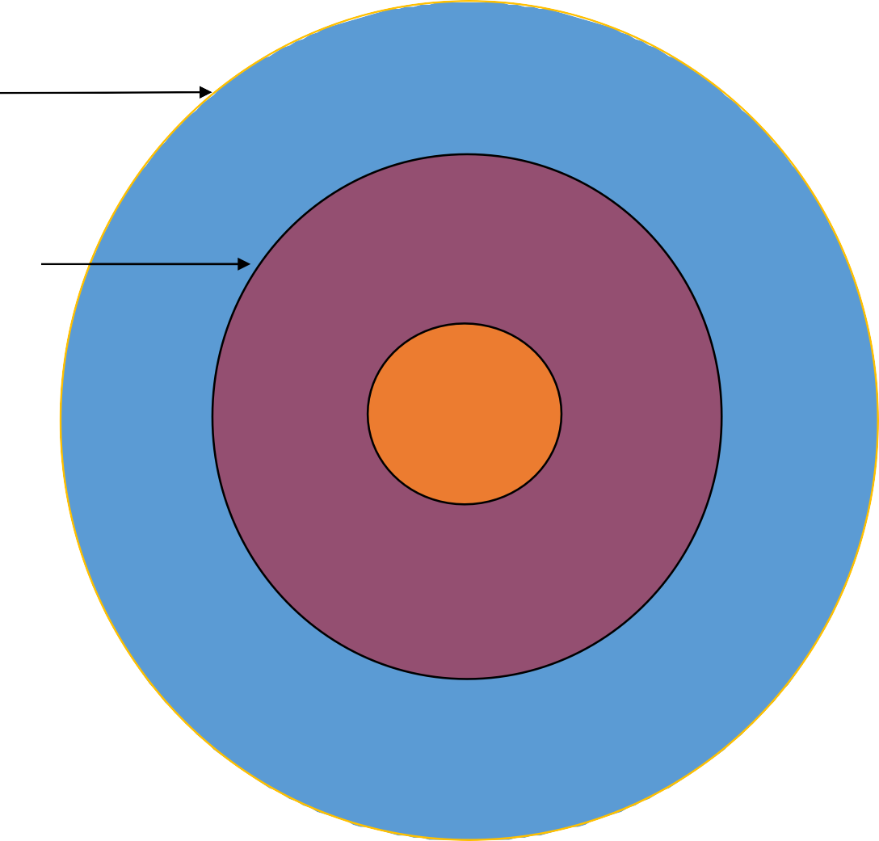
Situation Management
Circle of Interest
Interest
Circle of Influence
Influence
Circle of Control
Control
Notes:
Control what you can control

Slide 12
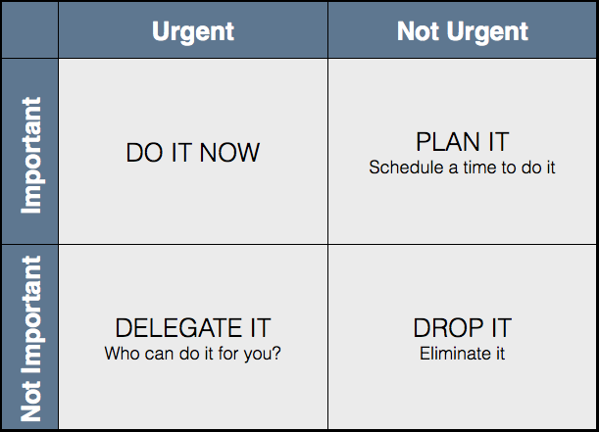
Eisenhower Principle

